Slide 1
Modern China

Slide 2
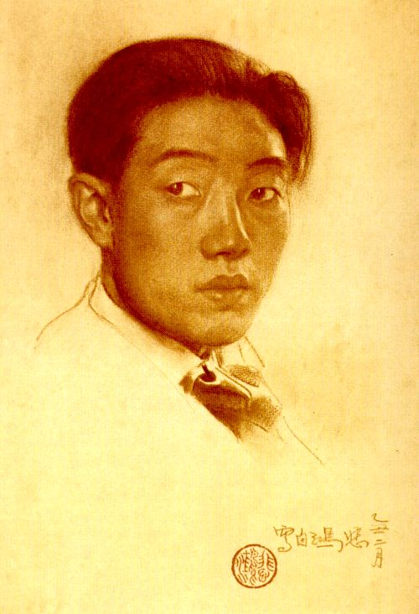
Xu Beihong (1895- 1953) Self Portrait, compressed charcoal on paper, n/d (1920s)
Xu Beihong traveled to Tokyo in 1917 to study arts. Beginning in 1919, Xu studied oil painting and drawing in Paris at the École Nationale Supérieure des Beaux-Arts. He came back to China in 1927.
Xu Beihong is widely considered the ‘‘founding father’’ of modern Chinese (“indigenous”) painting, including the mainstream Socialist Realist painting prescribed by Mao.

Slide 3
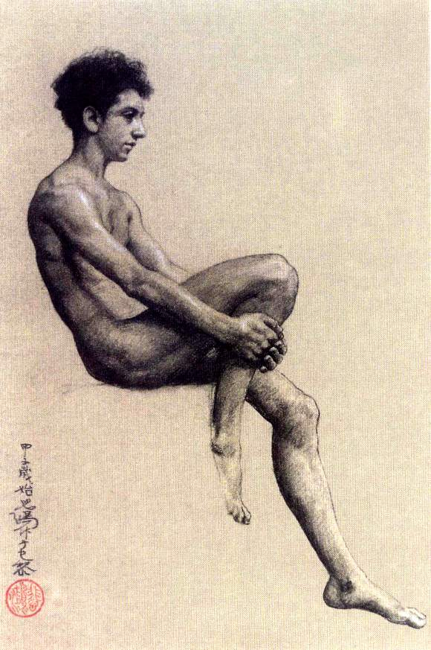
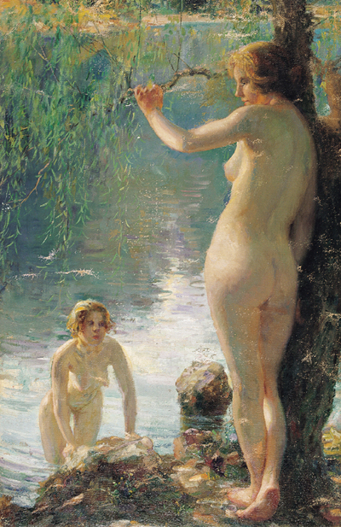
Xu Beihong, (above) Nude Study, charcoal and white chalk on paper, 1924 (left) Bathing, oil on canvas, 1924

Slide 4
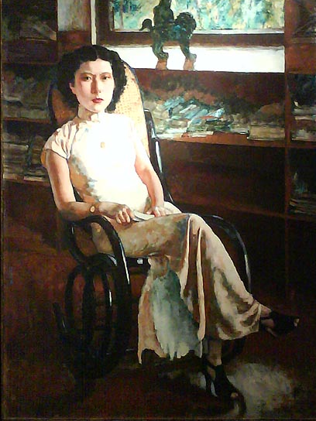
Xu Beihong, Portrait of Jenny, oil on canvas, 1939. Jenny was a Cantonese dance hostess from Singapore. This painting was commissioned by the vice-consul of Belgium to Singapore.

Slide 5
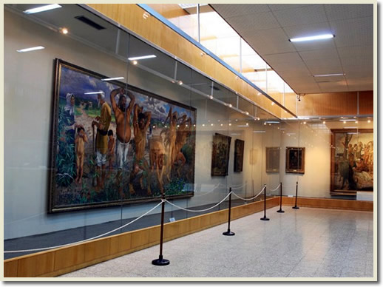
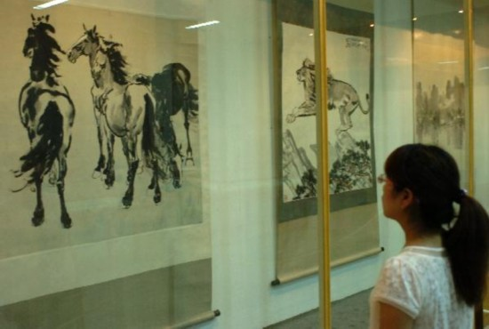
Xu Beihong museum, Beijing, showing 1200 of his artworks, including here, Foolish Old Man Moved Mountains on left and his signature horse and other animal paintings on right.
http://kaichang.typepad.com/photos/xu_beihong/index.html

Slide 6
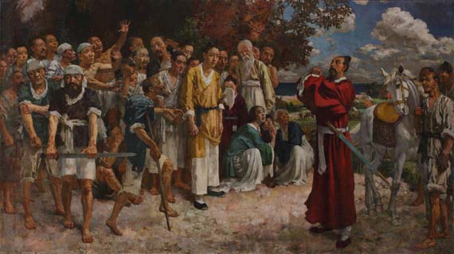
Xu Beihong, Tian Heng and His Five Hundred Warriors, 1928-1930. The Xu Beihong Memorial Museum. Xu Beihong returned to China in 1927

Slide 7
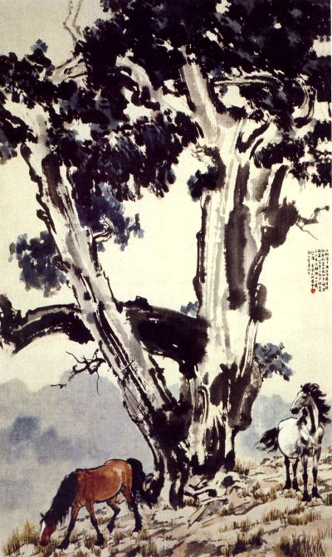
Xu Beihong, Two Horses under Tall Tree, 1937, ink and color on paper, 131 x 77 cm

Slide 8
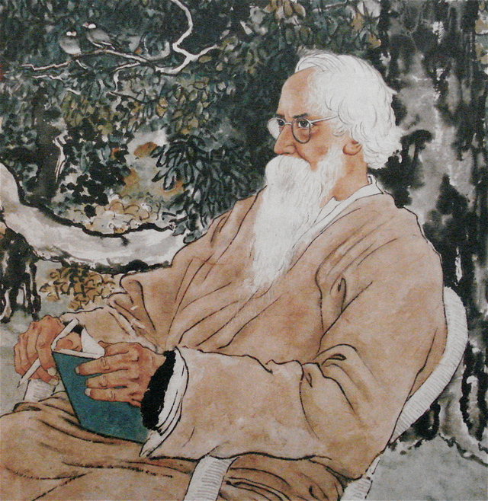
Xu Beihong, Rabindranath Tagore, ink and color on paper, 1940 Would they have agreed about modern art?

Slide 9
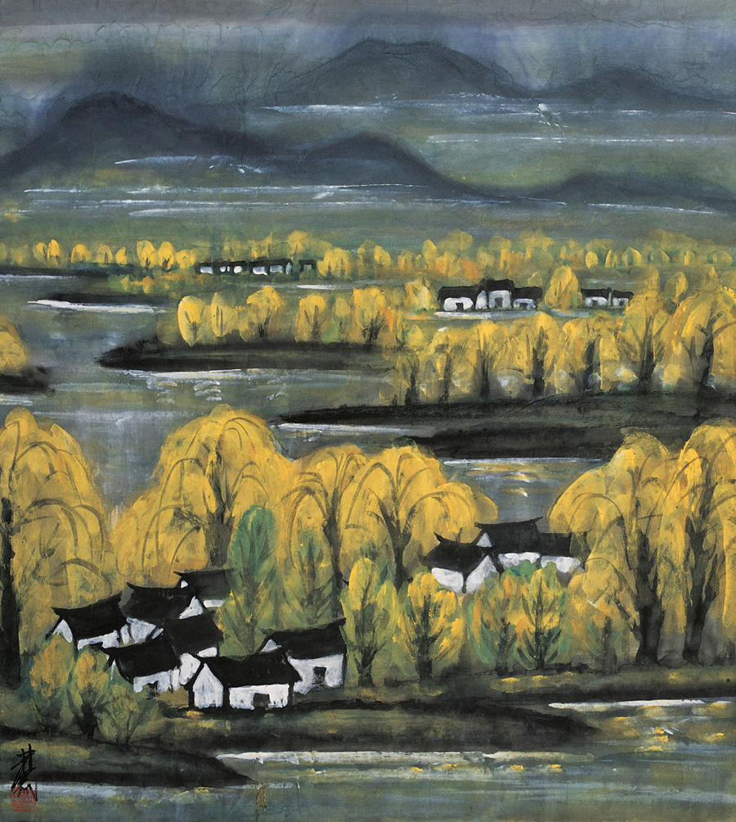
Lin Fengmian (1900-1991), Autumn in Jiangnan, n/d, ink on paper

Slide 10
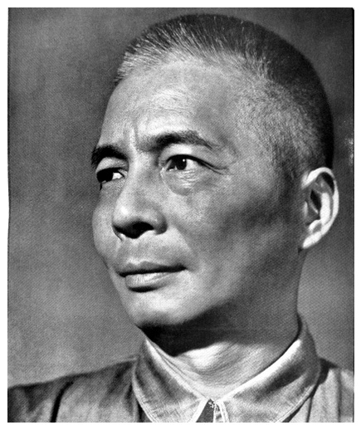
Ni Yide (1901 - 1970), painter and art critic. Studied in Japan at Kawabata Art Academy, 1927-30. This photo is from the 1930s. Ni Yide is believed to have died as a result of torture during the Cultural Revolution.

Slide 11
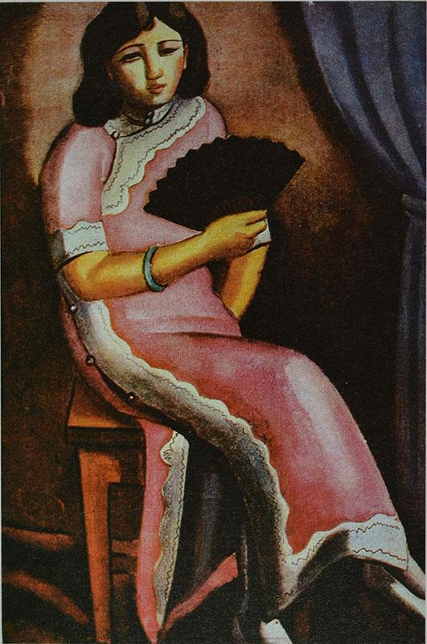
Ni Yide, Summer, oil on canvas, 1932

Slide 12
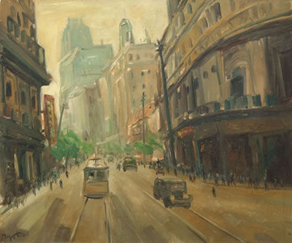
Ni Yide (1901-1970), Nanjing Road (Shanghai), 1947, oil on canvas

Slide 13
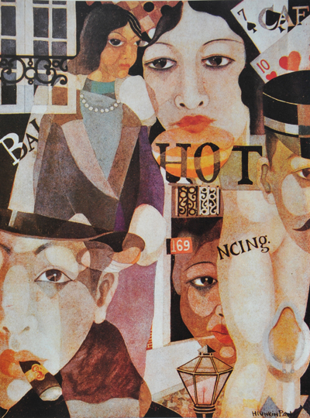
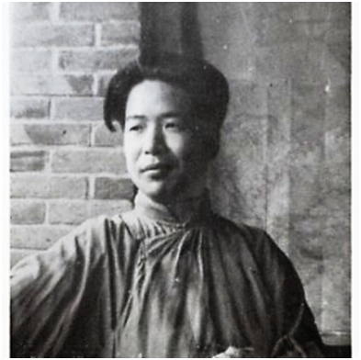
Pang Xunqin (1906-85), Such is Paris, 1931 (lost in 1937)
A member of China’s first generation of foreign-trained oil painters who came of age during the Republican era. At age nineteen, he left to study in Paris and returned to Shanghai when he was twenty-four. (1925-30)

Slide 14
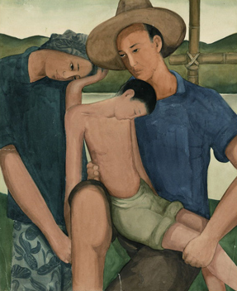
Pang Xunqin, Son of the Earth, shown in the final Storm Society exhibition in 1934. For this work, according to Croizier, he “received threats to his person as well as criticism of the painting”
Many of Pang Xunqin’s early works were destroyed by Japanese soldiers during the Second Sino-Japanese War (1937-1945) and many of his later works were destroyed during the Cultural Revolution. Denounced by the Gang of Four, Lin destroyed his own works. He was imprisoned by the regime for over four years.

Slide 15
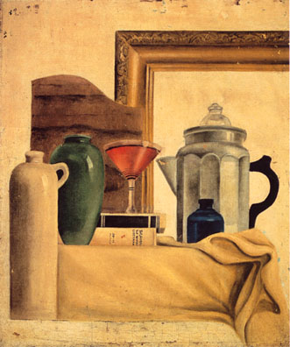
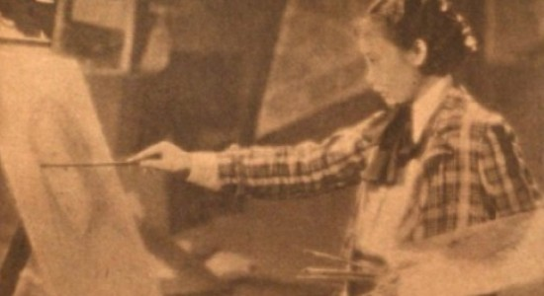
Qiu Ti (1906-1958), Still Life, undated (1931-1933), oil on canvas 44 x 53 cm. Shown in the 3rd Storm Society exhibition, 1933. Photo of Qiu Ti painting
“The biggest controversy [around the Storm Society exhibition] arose over a prize-winning entry by the only woman member, Qiu Ti (Mrs. Pang Xunqin). Reproduced in several magazines (unfortunately not in color), what disturbed critics and casual onlookers was the fact that in a decorative picture of a potted plant she had painted the leaves red and the flowers green” (Croizier).

Slide 16
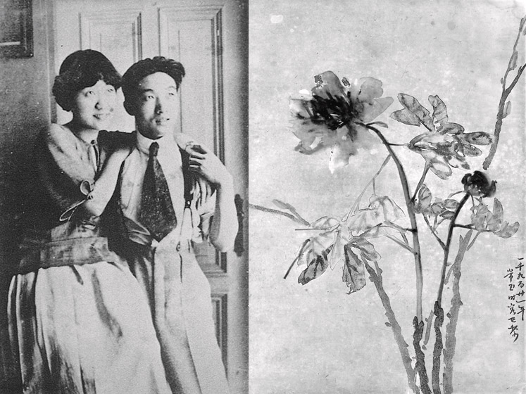
Left: Xu Beihong and Jiang Biwei in Paris, ca. 1923 Right: Peonies by Sanyu, ink and watercolor on paper, 1921, 43.5 x 60.5cm.

Slide 17
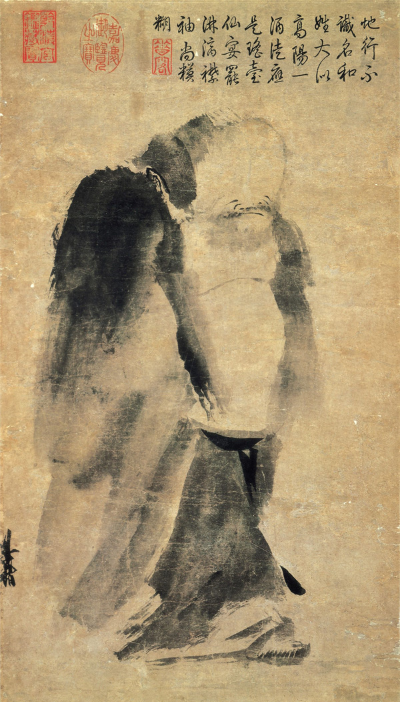
Liang Kai (梁楷, c.1140-1210), Immortal in Splashed Ink (潑墨仙人) Song Dynasty (960-1279), hanging scroll, ink on paper, 48.7 x 27.7 cm, National Palace Museum, Taipei The “modernism” of Chinese ink painting ca.1200

Slide 18
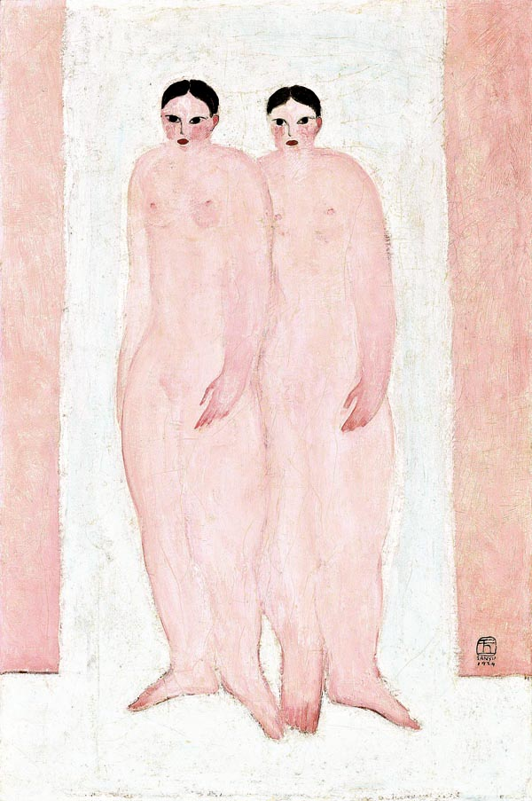
Sanyu (Chang Yu, 1901-1966), Two Pink Nudes, oil on canvas, 1929
http://www.artofsanyu.com/index.php

Slide 19
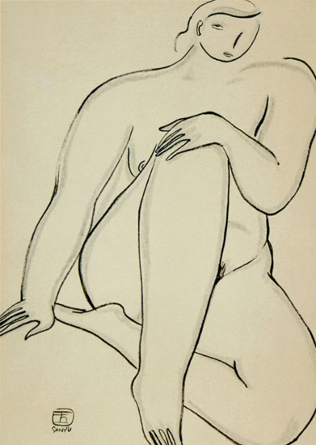
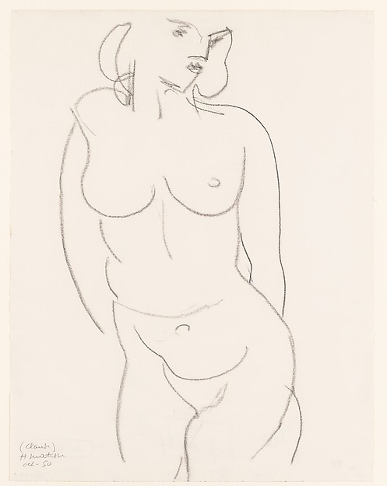
Sanyu (Chang Yu), Seated Woman, 1920-1930, ink and pencil on paper, 59cm x 41.8cm (right) Henri Matisse, Nude Torso (Claude), 1950, charcoal on paper, 20 3/4 x 16 in. (52.7 x 40.6 cm)

Slide 20
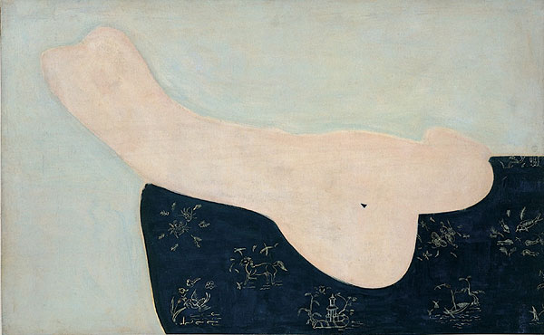
Sanyu (Chang Yu), Reclining Nude, 1930’s, oil on canvas, 81cm x 130cm

